Slide 1
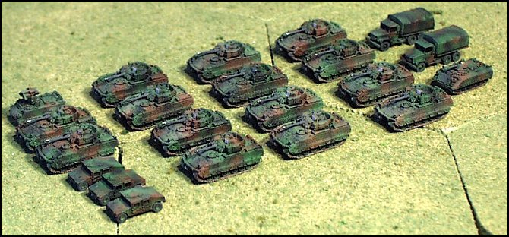
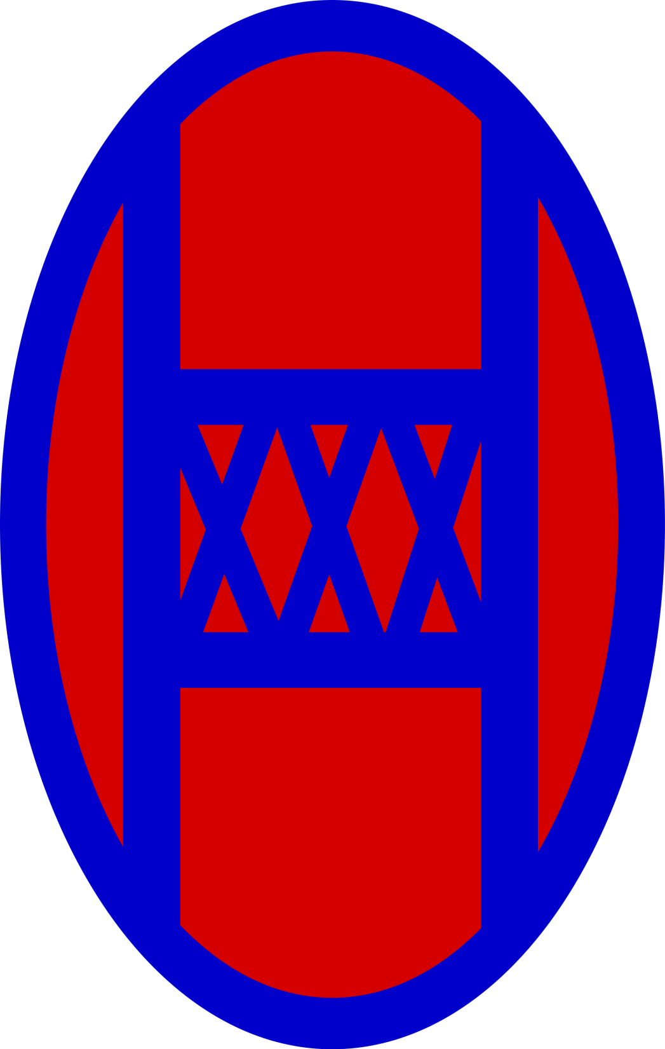

Slide 2
30th Heavy Brigade Combat Team
Formed from the downsized 30th Infantry Division of World War II
Nicknamed “Old Hickory” brigade after Andrew Jackson
In 1974 the Division ceased to exist and its units were divided into the North Carolina, South Carolina, and Georgia Army National Guards

Slide 3
30th Heavy Brigade Combat Team
In 2003 the 30th Brigade was informed that it would be deployed as a part of Operation Iraqi Freedom
In February 2004 the Brigade began a year long deployment.
In doing so the 30th Brigade became the first National Guard Brigade Combat Team to be deployed within the last 50 years
By the end of this deployment the Brigade had lost 5 soldiers

Slide 4
30th Heavy Brigade Combat Team
In early 2005 the Brigade returned from Iraq and the 3oth Infantry Brigade transformed into the Heavy Brigade Combat Team
The 119th Infantry Regiment was disbanded
The 1st Squadron, 150th Calvary Regiment, 30th Special Troops Battalion were gained

Slide 5
30th Heavy Brigade Combat Team
In 2007 the Brigade was again informed that it would be deployed.
Operation Iraqi freedom VII was underway by early may of 2009
Within a month the Brigade had already begun to suffer casualties

